Slide 1
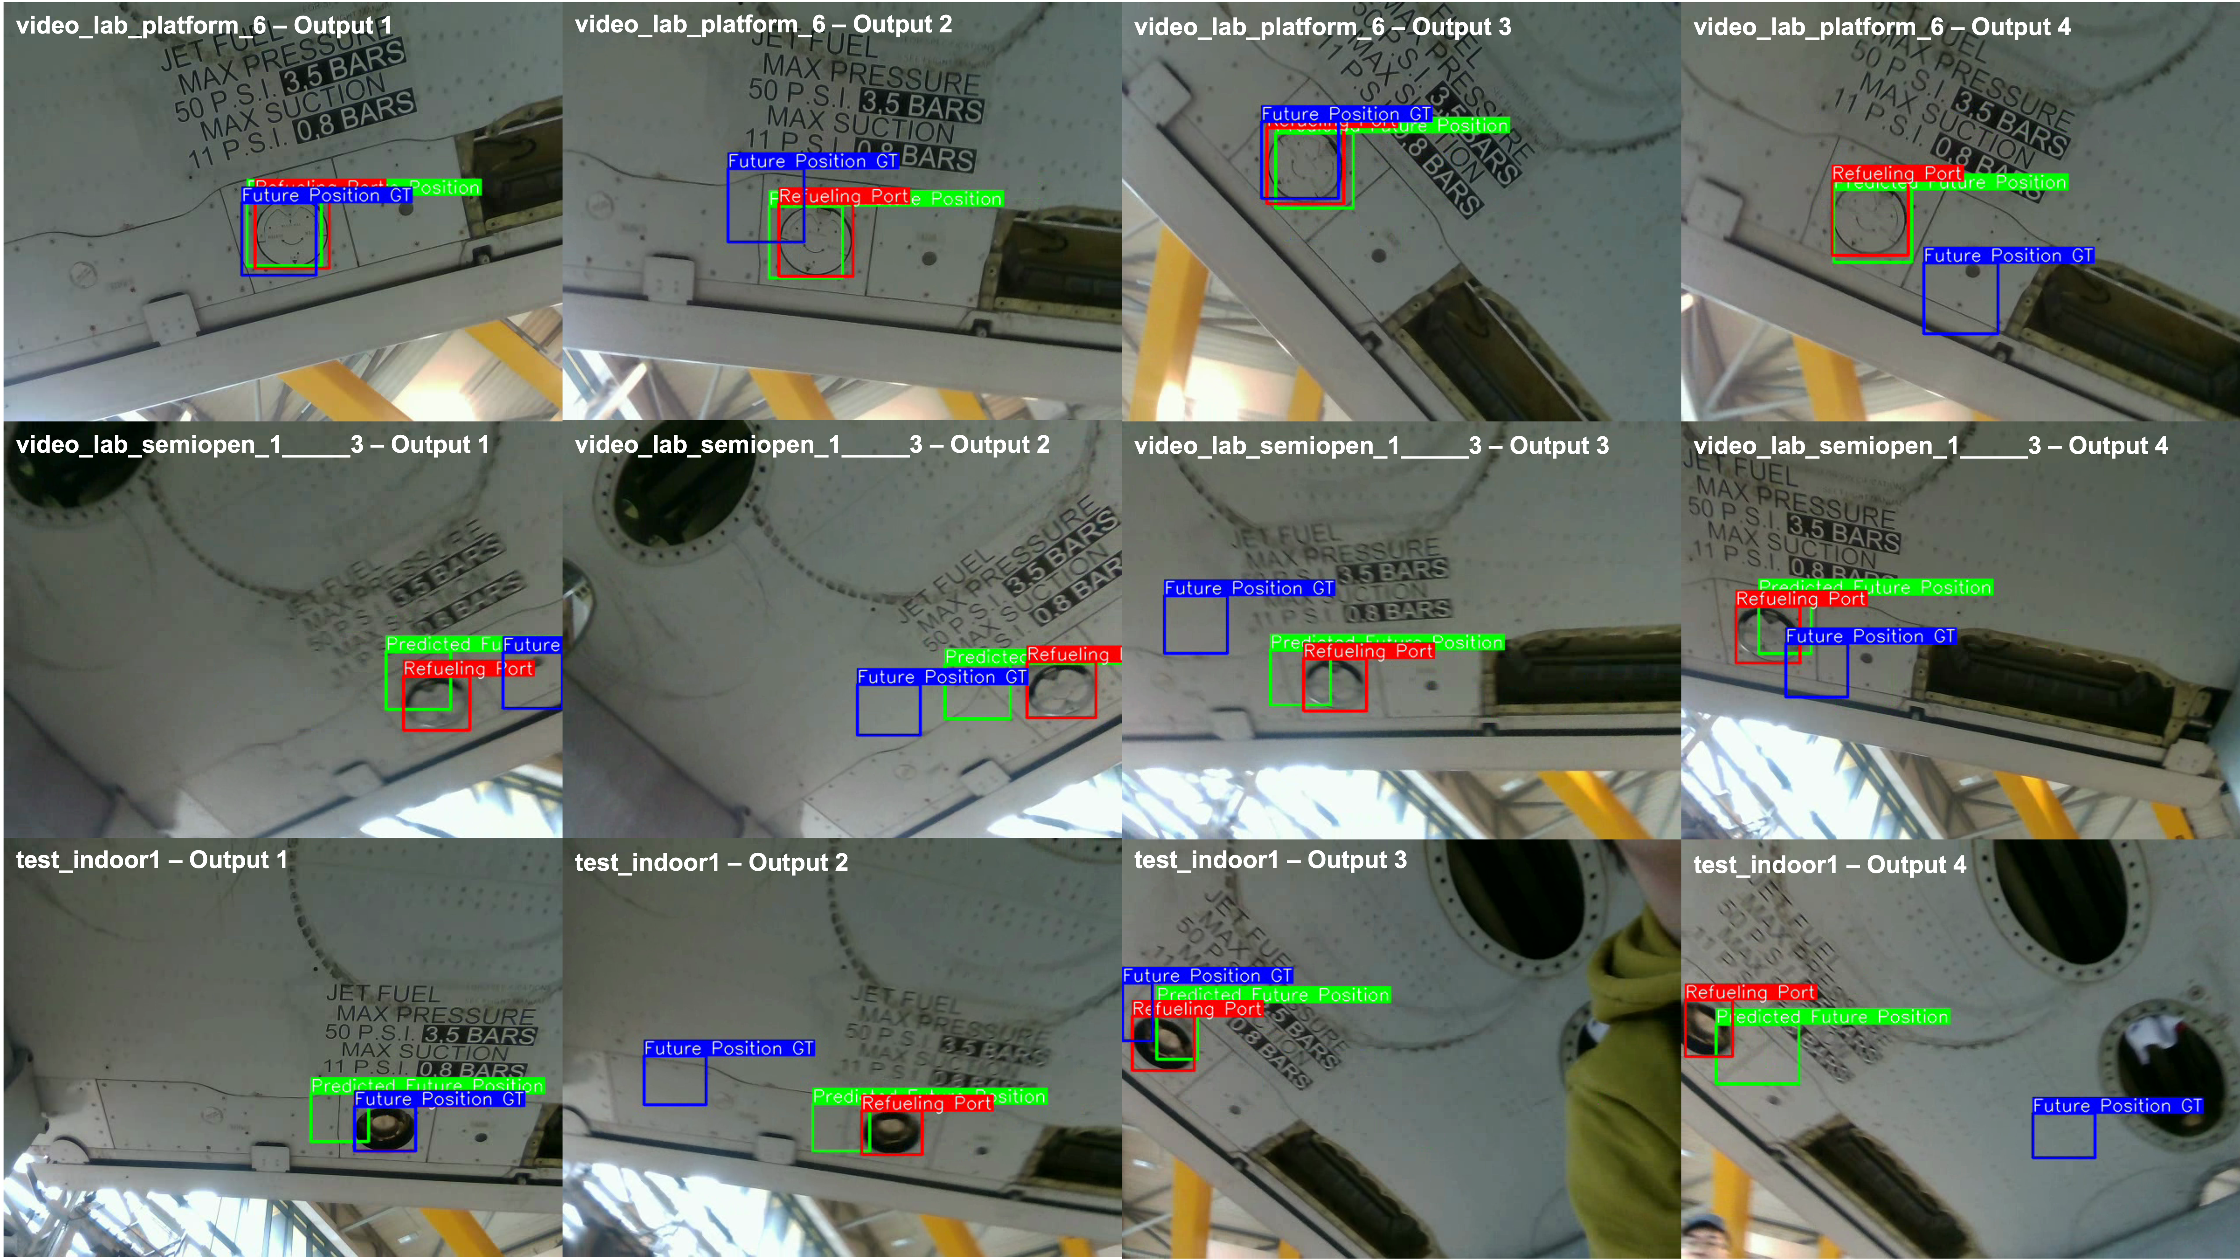
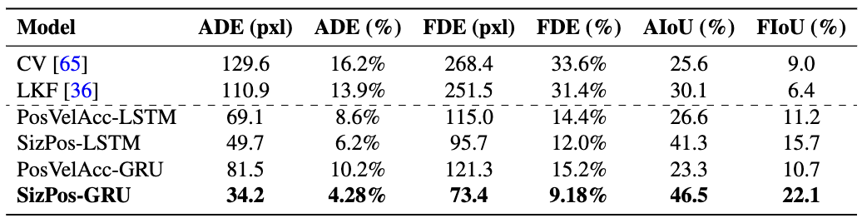
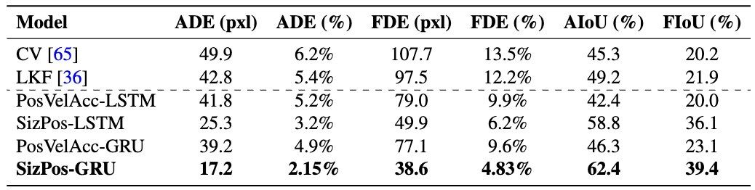

Future Position Prediction for Pressure Refuelling Port of Commercial Aircraft
Introduction: Automating ground pressure refuelling for commercial aircraft requires precise detection and prediction of refuelling ports. Current methods face challenges with real-time accuracy and adaptability.
Goal: Develop a framework for predicting the future position of commercial aircraft refuelling port using advanced Object Detection models and Deep Learning to leverage the spatial-temporal relationship between frames in a video.
Objectives: Review state-of-the-art object detection and sequence models. Annotate and preprocess the Airbus A320 Refuelling Port (AARP) dataset. Design a framework for accurate tracking and prediction of aircraft refuelling port positions.
Contributions: Developed the SizPos-GRU model for spatial-temporal predictions. Fine-tuned YOLOv10 for real-time detection. Applied advanced filtering techniques like the Savitzky-Golay and Kalman Filters to enhance prediction stability.
Methodology: Annotated the AARP dataset and trained the SizPos-GRU model. Integrated YOLOv10 for detection and tested various smoothing filters. Evaluated the framework under diverse scenarios.
Results: SizPos-GRU outperformed baseline models with an Average Displacement Error (ADE) of 34.2 pixels and a Final Displacement Error (FDE) of 73.4 pixels for 60-frame predictions (see Table 1). For shorter 30-frame predictions, the model achieved an ADE of 17.2 pixels and a FDE of 38.6 pixels (see Table 2).
Conclusion: The framework accurately predicts refuelling port positions, advancing aircraft refuelling automation. Future work will explore more diverse datasets and models.
PosSiz-GRU Model Architecture
Encoder Architecture
Framework Workflow
Decoder Architecture
Decoder Architecture
Table 1: Performance comparison of various models on trajectory prediction tasks using 30 past frames to predict 60 future frames.
Visualisation of the trajectory prediction framework output. The figure shows the predicted future position in 30 frames (green), the ground truth future position in 30 frames (blue), and the current detection of the refuelling port (red).
Table 2: Performance comparison of various models on trajectory prediction tasks using 15 past frames to predict 30 future frames.
Alexis BALAYRE Email: alexis.balayre.500@cranfield.ac.uk
Supervisors: Dr. Boyu Kuang & Dr. Stuart Barnes

